Slide 1
Machine Learning
Day 1
By
Pankaj Shukla
JD, NIELIT Lucknow
Notes:
1

Slide 2
Delivery Method
E- Learning portal of NIELIT - http://eclass.nielitvte.edu.in/
Google Meet – Link will be same throughout the course
Whatsapp
Email

Slide 3
What is Machine Learning?
What is Machine Learning ?
Have a feeling first……….
Child learns his /her mother Language

Slide 4
Traditional Programming
Process
Input
Output
y = x1 + x2
Or
y = f (x1,x2)
x1,x2
y

Slide 5
Machine Learning
x1 (Input) | y (Output)
2 | 4
3 | 6
4 | 8
5 | 10
6 | 12
7 | 14
8 | 16
y = 2 multiplied by x1

Slide 6
Machine Learning
Machine Learning Algorithm
Input
Process
Output
Machine Learning Algorithm
x1,x2
y=f(x1,x2)
y

Slide 7
Application
What do you understand by experience of A Doctor

Slide 8
Application
Social Media: Facebook, Twitter

Slide 9
Application
E-Commerce App like :
Amazon
Flipkart

Slide 10
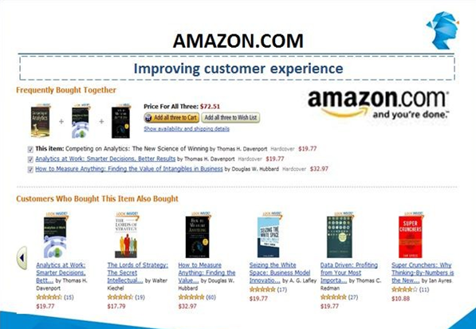

Slide 11
Application
Government:
Railway,
Income Tax
etc.

Slide 12
Application
Banking Applications

Slide 13
Machine Learning
AI
Machine Learning
Deep Learning

Slide 14
TYPES OF MACHINE LEARNING PROBLEMS

Slide 15
Classification
Examining the feature of a newly presented object and assigning it to one of the predefined classes.
For Example:
Classifying loan applications as Low, Medium and High Risk
Assigning product into Categories and sub-categories
Classifying people as BPL etc.

Slide 16
Estimation
Calculated approximation of a continuous variable
For Example:
Estimated household income for loan processing or credit card limit etc.
Estimated Crop production in an area
Estimated traffic at a place
Estimated future requirement for saving/investment

Slide 17
Affinity Grouping
Which things go together?
To understand the purchase behaviour of customers
Market Basket Analysis
For example:
If someone buys a book on Data Science, it is most likely that he will also buy some book on Python.
If someone buys Milk, he may buy bread or cornflakes.

Slide 18
Clustering
Segmenting heterogenous group of population into a more homogenous sub groups or clusters.
For Example:
Customer segmentation according to buying behaviours
Creating cluster of patients with similar symptoms to identify deceases

Slide 19









Typical Process of Machine Learning
Decision Making Problem
Insight Development
Decision Making
Requirement Understanding
Data Understanding
Data Preparation
Data Exploration
Modeling & Evaluation
Deployment
The most time- consuming part
The most exciting part
Modeling Problem

Slide 20
Python is a general purpose high-level programming language
Python as a Programming Language
Machine Learning
Web development
Networking
Scientific computing
Data analytics
…

Slide 21
Python as a Machine Learning Tool
The nature of Python makes it a perfect-fit for machine learning:
Easy to learn
Readable
Scalable
Extensive set of libraries
Easy integration with other apps
Active community & ecosystem

Slide 22
Popular Python Data Analytics Libraries
Library | Usage
numpy, scipy | Scientific & technical computing
pandas | Data manipulation & aggregation
mlpy, scikit-learn | Machine learning
theano, tensorflow, keras | Deep learning
statsmodels | Statistical analysis
nltk, gensim | Text processing
networkx | Network analysis & visualization
bokeh, matplotlib, seaborn, plotly | Visualization
beautifulsoup, scrapy | Web scraping

Slide 23
IDE For Python Programming
Jupyter Notebook
Spyder
Python IDLE
Anaconda distribution package:
https://www.anaconda.com/distribution/

Slide 24
Comparison – R vs. Python
Comparison between R and Python has been absolutely one of the hottest topics in data science communities:
R came from the statisticians community, whereas Python came from the computer scientists community
Python is said to be a challenger against R, but in general it’s a tie
It’s up to you to choose the one that best fits your needs

Slide 25
What is in this course?
Python – Preferred programming language for Machine Learning
Implementation of Machine Learning Algorithm
Mini projects to solve different kind of Machine Learning Problems

Slide 26
Tomorrow Agenda
Python Programming Basics
THANKS

